Slide 1
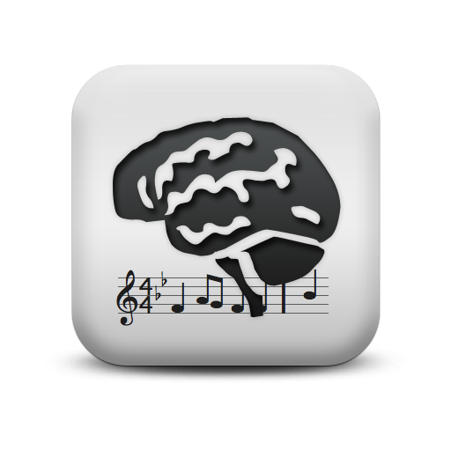
Smart Player Piano
Presentation for IEEE Cincinnati
May 27, 2010
Jason Pawlak
Advisor: Dr. Anca Ralescu

Slide 2
Purpose
To create an intuitive, fun and enlightening application that combines both visual and audible arts

Slide 3
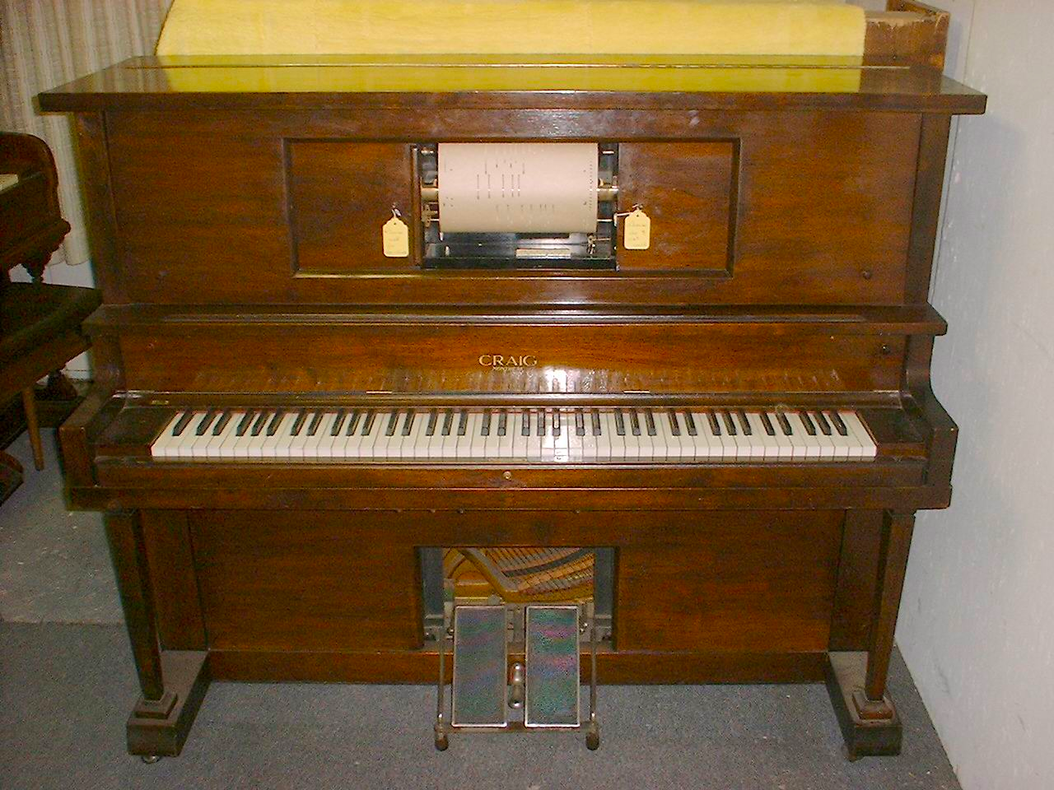
What is a player piano?
Powered by person pushing pedals!
Vacuum detects where holes on scroll are located
Holes further to the right are higher pitch than holes further to the left

Slide 4
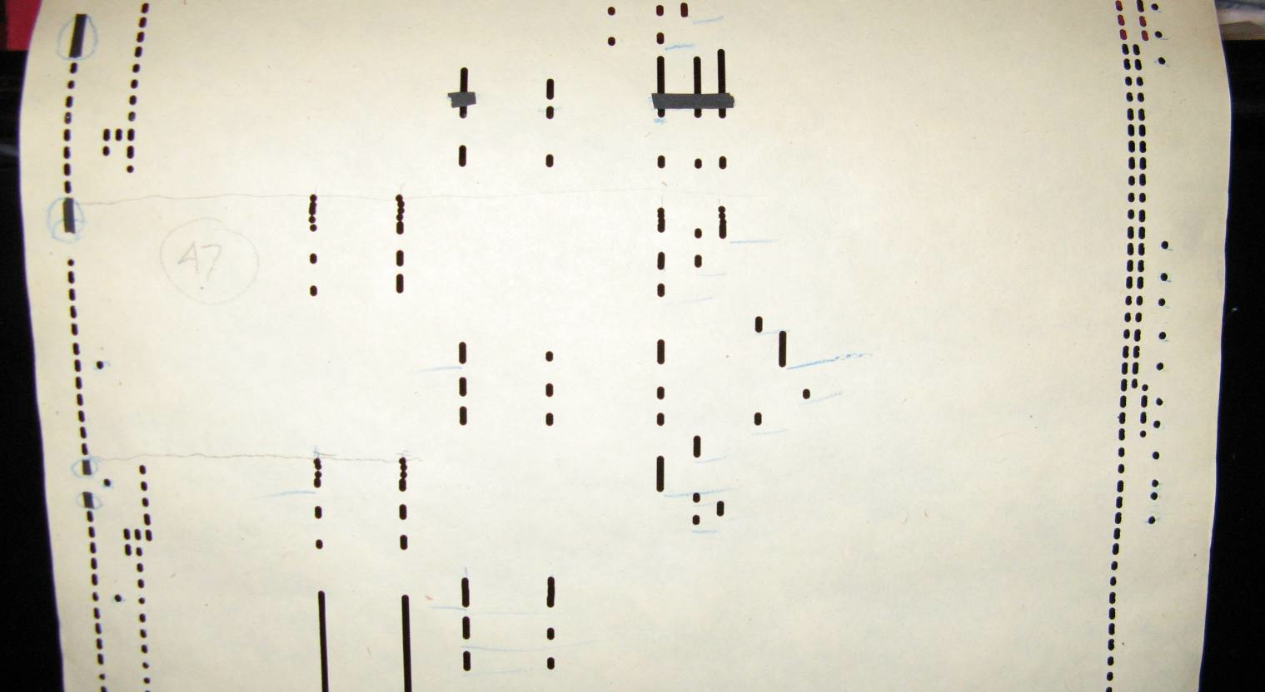
Player Piano Roll

Slide 5
Demonstration

Slide 6
Blank Canvas

Slide 7
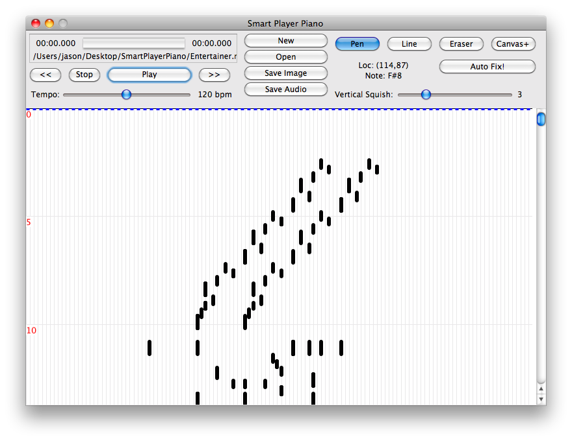
Import MIDI

Slide 8
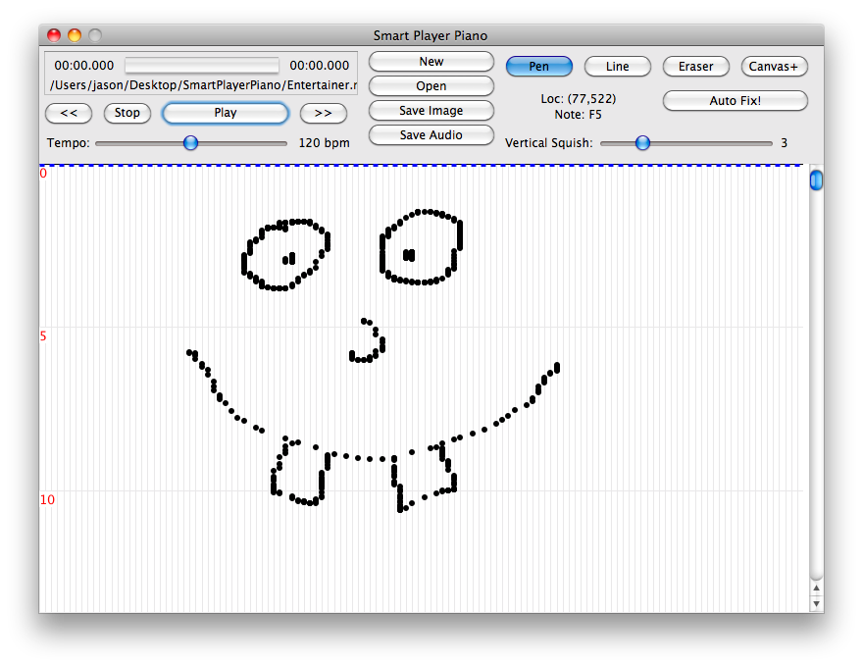
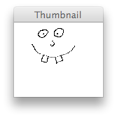
Draw Picture

Slide 9
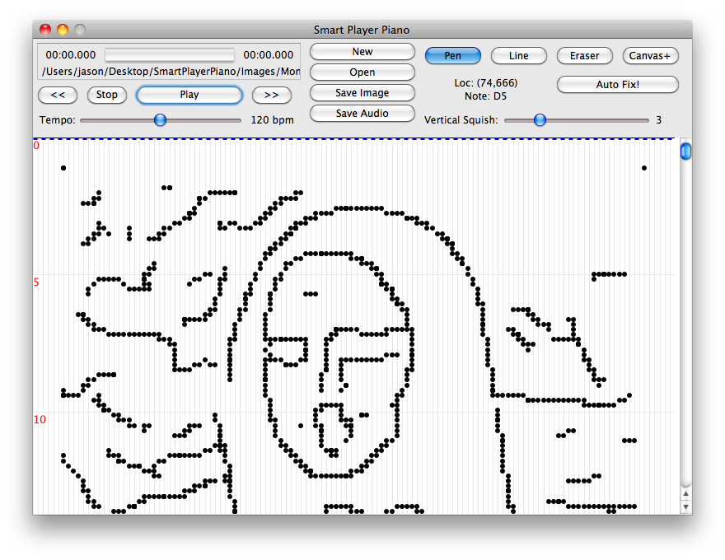
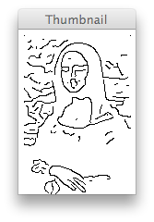
Import Picture

Slide 10
AutoFix
Move notes slightly to follow basic music theory rules
Music Theory
Set of 7 notes make up a key
Certain notes when played together sound better than other notes played together
The distance between two notes is called an interval
Three notes at specific intervals from each other make a chord
Specific chords sound best played after other specific chords

Slide 11
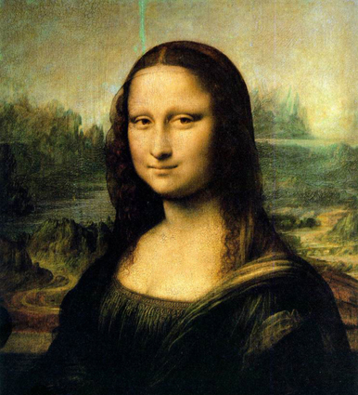
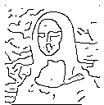
Image Progression

Slide 12
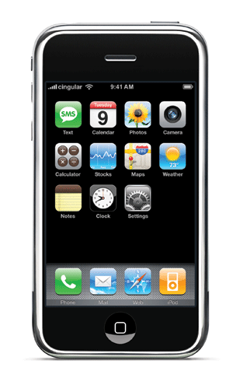
Future Development
Make application available for download online
Mobile platform development
iPhone
Android

Slide 13
Questions?

